Slide 1
Microservices and RESTful API
Classroom

Slide 2
Safety, Health and Environment
Fire exits
Security
Internet access
Phones / mobiles
Messages
Helpdesk
Timings
Breaks
Lunch
Toilets

Slide 3
Meet & Greet
Take a minutes to introduce yourselves
Name
Current role, company
Pre course studies
What you do for fun
Notes:
Paired activity.
Ask each participant to introduce themselves to the other using the following format:
Name
Current role
Company
What is your biggest challenge at work that you hope to overcome post this course?
A tool or technique that you use on a daily basis and would like to share with others?

Slide 4
Online activity review
What are Microservices? Pros and cons
Domain driven design
Review of classic Monolithic design
Lab: a Microservice Design exercise
Polyglot Persistence
Lab - Using RDS database
Other forms of storage types
Lab - Using Amazon DynamoDB NoSQL Database
Topics
Notes:
In the class based sessions of the Microservice and API Module we will recap some of the topics covered in the on-line portion of the module and introduce new concepts.
During the on-line Monolith to Microservice lecture terms such as Domain Driven Design and Bounded Contexts were briefly mentioned but not expanded upon. Now we will give some background to these topics together with a Group Activity to help the students understand the concept and realise its not a Black or White design decision, but many shades of grey depending on technical and business requirements.
As we break into Microservices we have more opportunity to choose the right tool to do the job. Primarily this is the focus of the Polyglot approach.
Following DDD, Bounded Context and Polyglot principals we can break down the monolith one step at a time. So we have to plan how we will “Strangle the monolith” as we go on our Microservice journey.
Breaking our application components into tens or possibly hundreds of microservices, coordination of activities between these services can become difficult. Here we will identify these issues and the models possible used to overcome them.
Also as the number of microservices increase and maybe individual microservices scale to multiple instances, communication can become difficult. Some communication will be purely internal, some external or both. During this section we will look at some of the services used for communication
To bring all of the microservices principals together with a number of cloud services (AWS). Some AWS Services will be discuss in the final section to give background knowledge needed to help understand the goals of the final lab. There is also an additional lab if time permits.

Slide 5
Microservice transaction
Lab- Using AWS Step service
What are containers?
Lab – Containerise a NodeJS application
Microservice communication
Lab- AWS Fargate for Deployment of Container Apps
Using the API gateway
Lab - Build RESTful Microservices with AWS Lambda and API Gateway
Other AWS cloud service that is often used with Microservices
Topics
Notes:
Paired activity.
Ask each participant to introduce themselves to the other using the following format:
Name
Current role
Company
What is your biggest challenge at work that you hope to overcome post this course?
A tool or technique that you use on a daily basis and would like to share with others?

Slide 6
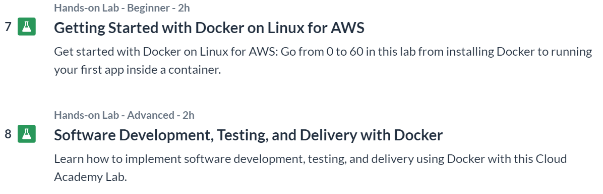
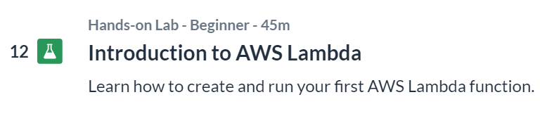
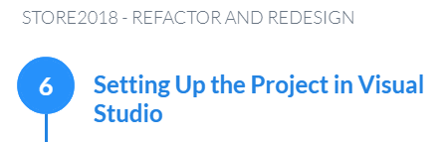
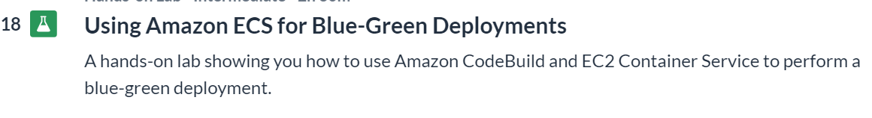
Pre-course labs

Slide 7
Based on the online activities, review the following topics:
What is a Microservice?
What is a RESTful API?
What is the difference between
IaaS AWS Azur, GCP Leasing a car
PaaS AWS EBS Taxi!
SaaS WebEx, DropBox S3 Bus!
What is FaaS? (Lambda is an example of an AWS Service)
Based on the online activities, review the following topics:
What is a Microservice?
What is a RESTful API?
What is the difference between
IaaS
PaaS
SaaS
What is FaaS?
Online Activity Review
Notes:
As a brief class discussion, directed Q&A or whiteboarding session recap some of the topics covered in the On-line Cloud Academy sessions. – as directed by the tutor.
These are topics that will be covered again during the classroom sessions with Labs to enforce and identify any lack of understanding.
The focused title of the course is microservies and RESTfulAPIs so a fundamental understanding of what a defines a microservice is important.
To quote Martin Fowler:
The term "Microservice Architecture" has sprung up over the last few years to describe a particular way of designing software applications as suites of independently deployable services. While there is no precise definition of this architectural style, there are certain common characteristics around organization around business capability, automated deployment, intelligence in the endpoints, and decentralized control of languages and data.
“The microservice architectural style is an approach to developing a single application as a suite of small services, each running in its own process and communicating with lightweight mechanisms, often an HTTP resource API. These services are built around business capabilities and independently deployable by fully automated deployment machinery. There is a bare minimum of centralized management of these services, which may be written in different programming languages and use different data storage technologies.”
Cloud is becoming more popular by the day and microservices really fit in with the flexible, scalable and disposable nature of the cloud that can also assist in rapid deployment of infrastructure to support rapid deployment of code.
We are not expected to be cloud experts, there are dedicated courses around the cloud platform for this. A basic understanding of cloud terminology and technology to provide a platform for successfully running microservices is the goal.
Infrastructure at a hardware level is provided by the cloud platform. We ‘consume’ it as a piece of software picking elements from a list. Selecting many different parts of dishes from a comprehensive shopping list. As the choice is vast I have great deal of flexibility in what I build. But with that flexibility goes responsibility to choose correctly, configure correctly and maintain it right. A common offering to this IaaS Infrastructure as a Service offering is the VM (EC2 in AWS terms).
Perhaps the preference would be to have it build for you. Some choice is desirable but the menu a little more limited. PaaS not Plates of food as a service, but not far off, Platform as a Service.
If you need someone to take the greatest responsibility but less flexibility for you then of course there is always the Set Meal of the Menu. SaaS our Set meal as a Service now become Software as a Service – like a mail system.
A variation of the Iaas, PaaS and SaaS is FaaS. Late 2014 saw the release of this as a fully managed service by AWS as Lambda. Take your code upload it to the service. Configure your environment 128mb > 3gb memory (CPU scales accordingly), set a timeout up to 15mins (its not designed for long running processes) and away you go! Wait for an event to trigger it and only pay for what you use in 100ms portions.
There are a number of additional consideration for configuring Lambda, but these are beyond the scope of the module
We have spent, and will spend time using containers. During the online session an introduction to docker and AWS services was given. Whilst the are many ways of running our microservices, containers are still a popular. The provide the capability to easily run on-premise and then if required transition to a new environment such as the cloud. Many different platforms and orchestrators are available giving choice: Docker, OpenShift, Kubernetes, Mesosphere, ECS,EKS,AKS to name but a few. Subsequently this is an area we should be familiar with.
As we move towards a cloud architecture the preference is to be as cloud native as possible – architecting specifically for the cloud. To utilise the true benefits of the cloud: lower TCO, scalability, rapid deployment, flexibility etc. we need to consume services that are as much managed by the provided as we can. This removes the burden of managing infrastructure and the cost that it incurs. There will always be exception, generally however this is our goal. If then we can take advantage of serverless we follow a model that is designed to take managed services a step further by hiding the compute away from us. Its neither our or our organisations responsibility to provide, maintain and scale it. By its very nature we cant have serverless on-premise. The typical benefit of serverless is that we only pay for what we use and if we need it, its provided. Again, lower development effort, lower management effort, lower TCO.

Slide 8
Based on the online activities, review the following topics:
What is a Container? Docker
What is the difference between a VM and Docker?
What do we mean by 'serverless'?
List some of the Advantages and Disadvantages of using the cloud
Online Activity Review
Notes:
As a brief class discussion, directed Q&A or whiteboarding session recap some of the topics covered in the On-line Cloud Academy sessions. – as directed by the tutor.
These are topics that will be covered again during the classroom sessions with Labs to enforce and identify any lack of understanding.
The focused title of the course is microservies and RESTfulAPIs so a fundamental understanding of what a defines a microservice is important.
To quote Martin Fowler:
The term "Microservice Architecture" has sprung up over the last few years to describe a particular way of designing software applications as suites of independently deployable services. While there is no precise definition of this architectural style, there are certain common characteristics around organization around business capability, automated deployment, intelligence in the endpoints, and decentralized control of languages and data.
“The microservice architectural style is an approach to developing a single application as a suite of small services, each running in its own process and communicating with lightweight mechanisms, often an HTTP resource API. These services are built around business capabilities and independently deployable by fully automated deployment machinery. There is a bare minimum of centralized management of these services, which may be written in different programming languages and use different data storage technologies.”
Cloud is becoming more popular by the day and microservices really fit in with the flexible, scalable and disposable nature of the cloud that can also assist in rapid deployment of infrastructure to support rapid deployment of code.
We are not expected to be cloud experts, there are dedicated courses around the cloud platform for this. A basic understanding of cloud terminology and technology to provide a platform for successfully running microservices is the goal.
Infrastructure at a hardware level is provided by the cloud platform. We ‘consume’ it as a piece of software picking elements from a list. Selecting many different parts of dishes from a comprehensive shopping list. As the choice is vast I have great deal of flexibility in what I build. But with that flexibility goes responsibility to choose correctly, configure correctly and maintain it right. A common offering to this IaaS Infrastructure as a Service offering is the VM (EC2 in AWS terms).
Perhaps the preference would be to have it build for you. Some choice is desirable but the menu a little more limited. PaaS not Plates of food as a service, but not far off, Platform as a Service.
If you need someone to take the greatest responsibility but less flexibility for you then of course there is always the Set Meal of the Menu. SaaS our Set meal as a Service now become Software as a Service – like a mail system.
A variation of the Iaas, PaaS and SaaS is FaaS. Late 2014 saw the release of this as a fully managed service by AWS as Lambda. Take your code upload it to the service. Configure your environment 128mb > 3gb memory (CPU scales accordingly), set a timeout up to 15mins (its not designed for long running processes) and away you go! Wait for an event to trigger it and only pay for what you use in 100ms portions.
There are a number of additional consideration for configuring Lambda, but these are beyond the scope of the module
We have spent, and will spend time using containers. During the online session an introduction to docker and AWS services was given. Whilst the are many ways of running our microservices, containers are still a popular. The provide the capability to easily run on-premise and then if required transition to a new environment such as the cloud. Many different platforms and orchestrators are available giving choice: Docker, OpenShift, Kubernetes, Mesosphere, ECS,EKS,AKS to name but a few. Subsequently this is an area we should be familiar with.
As we move towards a cloud architecture the preference is to be as cloud native as possible – architecting specifically for the cloud. To utilise the true benefits of the cloud: lower TCO, scalability, rapid deployment, flexibility etc. we need to consume services that are as much managed by the provided as we can. This removes the burden of managing infrastructure and the cost that it incurs. There will always be exception, generally however this is our goal. If then we can take advantage of serverless we follow a model that is designed to take managed services a step further by hiding the compute away from us. Its neither our or our organisations responsibility to provide, maintain and scale it. By its very nature we cant have serverless on-premise. The typical benefit of serverless is that we only pay for what we use and if we need it, its provided. Again, lower development effort, lower management effort, lower TCO.

